Slide 1

IT Digi
Solution

Slide 2
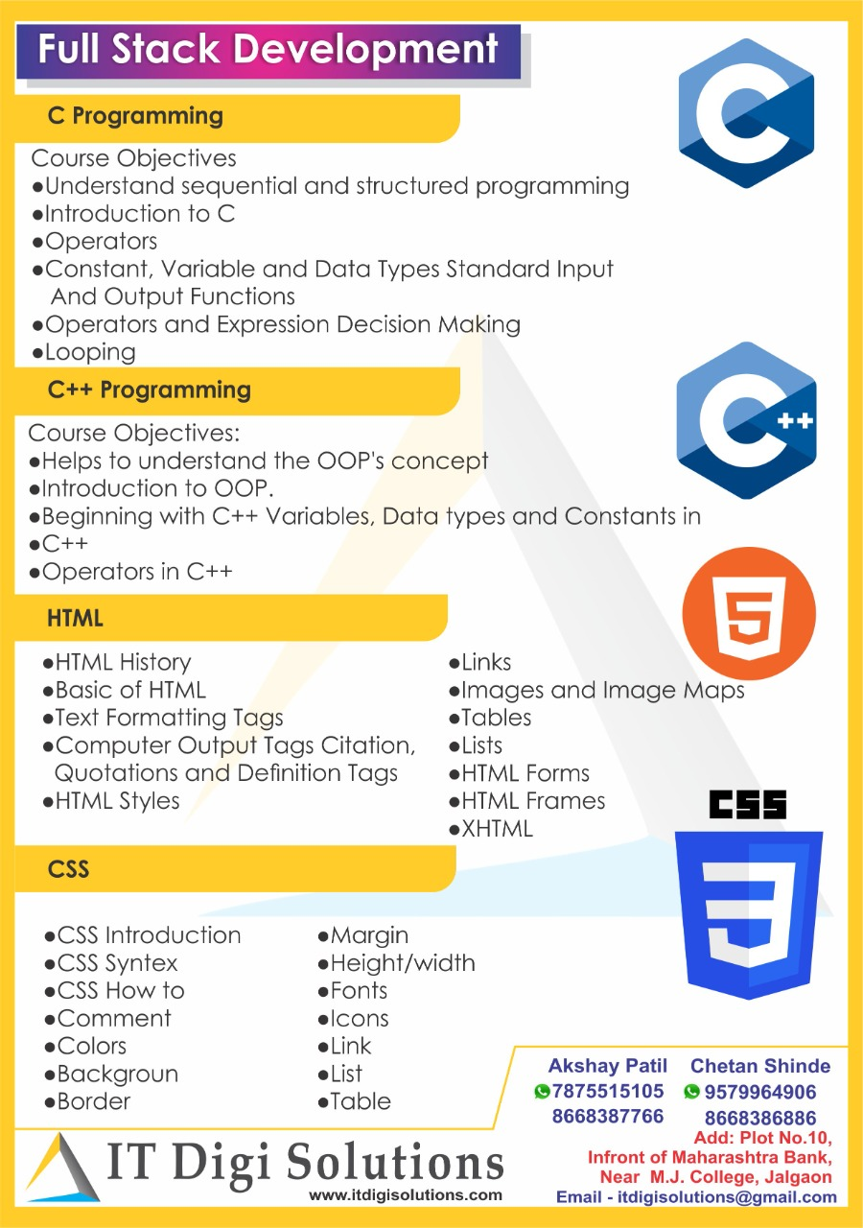

Slide 3
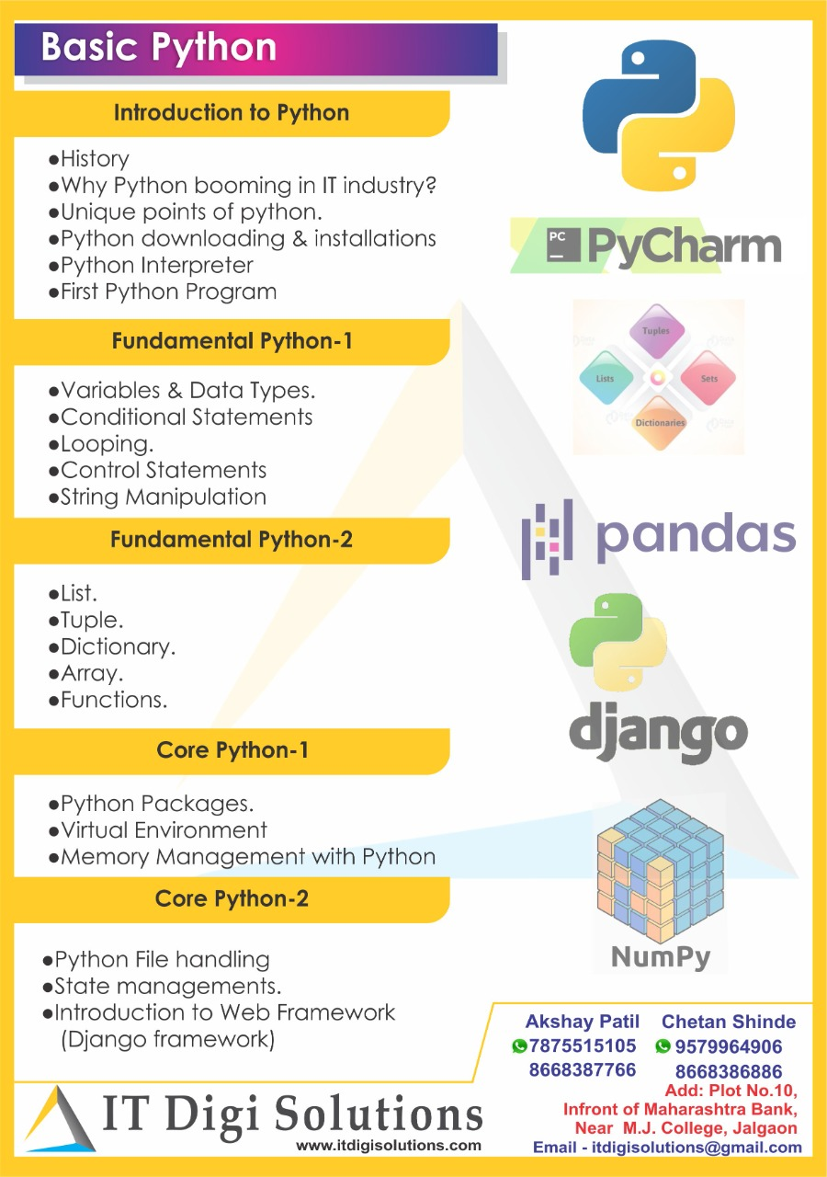


Slide 4
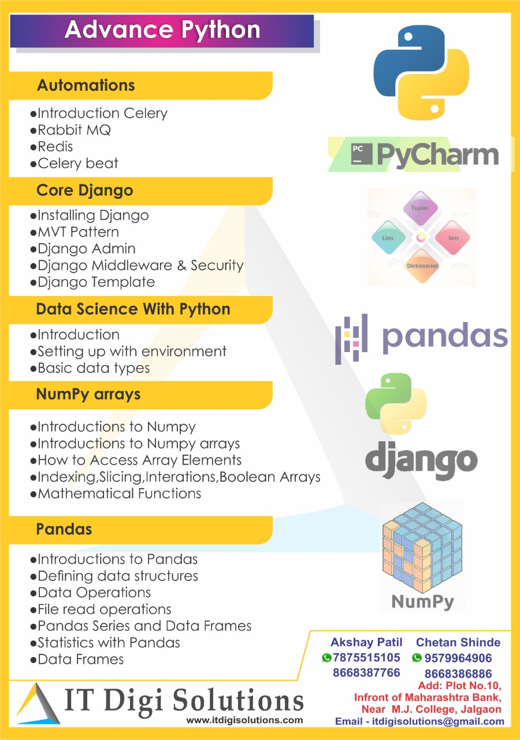

Slide 5
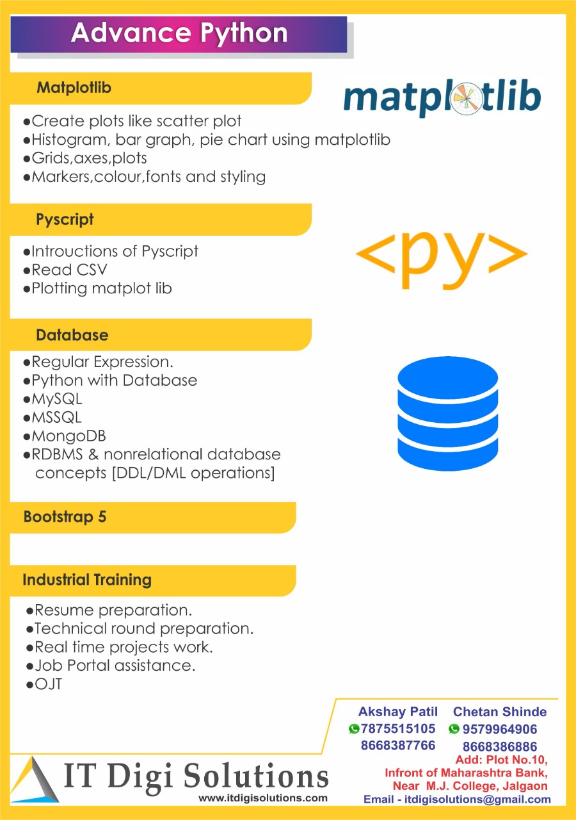

Slide 6
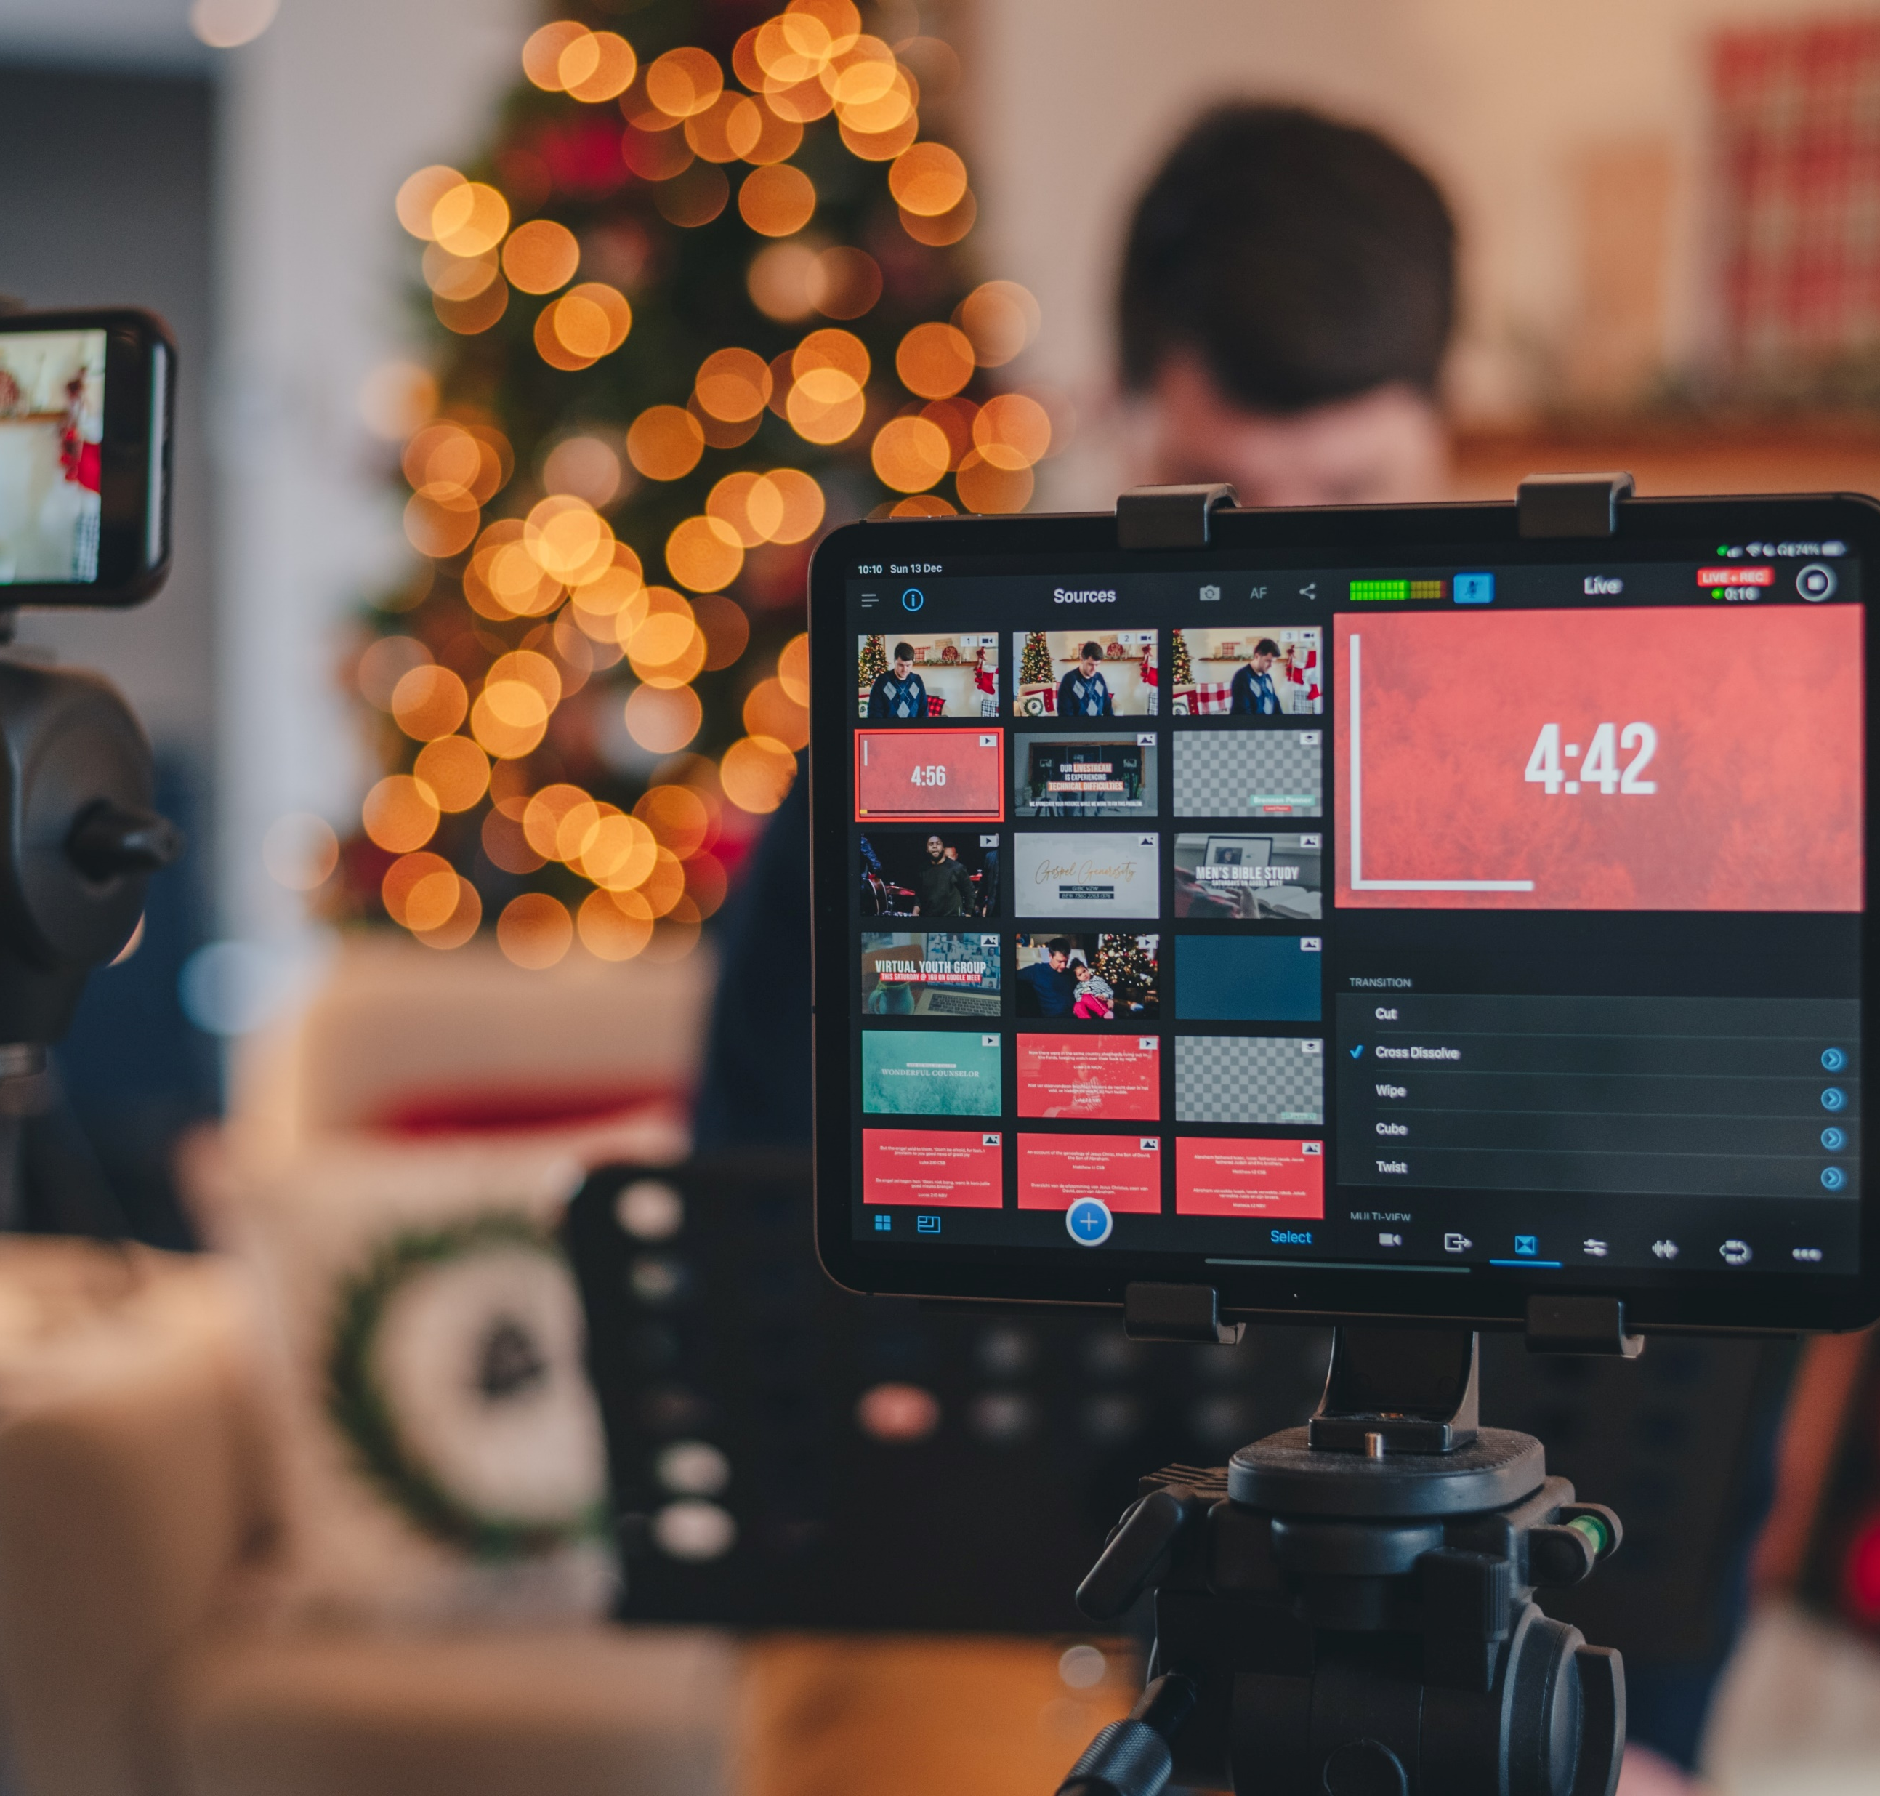
Feasibility Course
01
You can access the course in life time
02
We Building , industry’s level Real time projects ,
03
We are Providing a Full stack web Development

